Slide 1

Angular Pipes

Slide 2
Introduction
n any web application, we will get the data and display it in HTML pages in string formats.
The data might be coming from the server or some static local variables.
But in most of the cases we will not display the information directly in webpages.
We will do some transformations before displaying them in HTML pages.
For example, we will get the date information from the server in raw string format as shown below
Sun July 28 2019 00:00:00 GMT-0700 (Pacific Daylight Time)
Generally users likes to see the simple date formats in their locale or simply they want to see the date in the format shown below.
July 28 2019

Slide 3
What is an Angular Pipe?
Angular Pipe is just like a function which accepts input data and parameters, perform some operations and returns the data.
Angular Pipes are used directly in component template html files to transform the data just like styles.
Angular pipe takes in data as input and transforms it to a desired result.
We can pass optional parameters to Angular Pipe to transform the data further.
Angular Pipe can be combined with other pipes to perform series of operations.
Use Pipe Character | followed by the angular pipe name after the input data to transform.

Slide 4
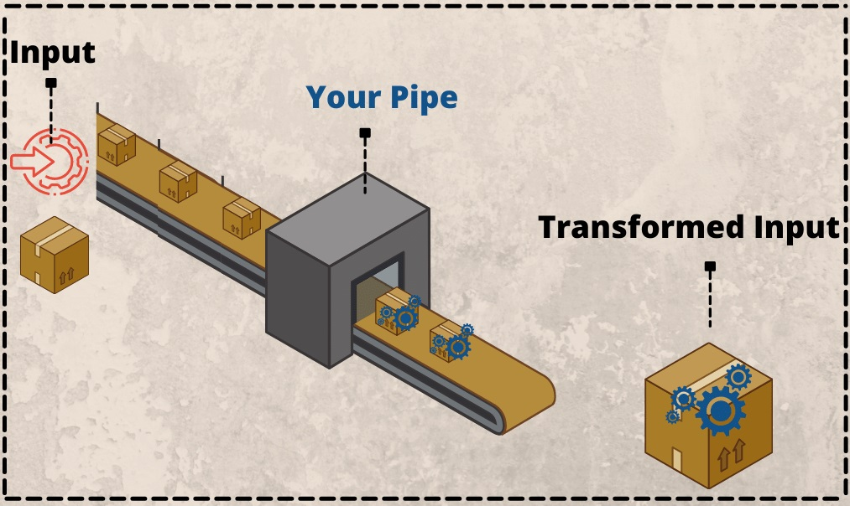
What is Pipe/Filter
Angular Pipes take data as input and transform it into an output.
The pipes purpose is to allow the transformation of an existing value and reusability.

Slide 5
Benefits of Pipes
It is simple.
It is reusable.
Pipes only run when the input changes (cached results).

Slide 6
Benefits of Pipes
Types of pipes
Pipes can be classified into:
1. Pure Pipes
A pure pipe is only called when Angular detects a change in the value or the parameters passed to a pipe.
2. Impure Pipes
An impure pipe is called for every change detection cycle no matter whether the value or parameter(s) changes.

Slide 7
Types of Pipes
DatePipe: Formats a date value according to locale rules.
UpperCasePipe: It transforms text to all upper case.
LowerCasePipe: It transforms text to all lower case.
CurrencyPipe: Transforms a number to a currency string.
DecimalPipe: Used to transform a number into a string with a decimal point.
PercentPipe: Transforms a number to a percentage string.

Slide 8
Types of Pipes
AsyncPipe: Used to read the object from an asynchronous source.
l18nPluralPipe: Converts a value to a string that pluralizes the value according to locale rules.
l18nSelectPipe: Used to display values according to the selected criteria.
KeyValuePipe: Converts an Object or Map into an array of key value pairs.
SlicePipe: Used to slice an array.
TitleCasePipe: Converts a string or text to title case.

Slide 9
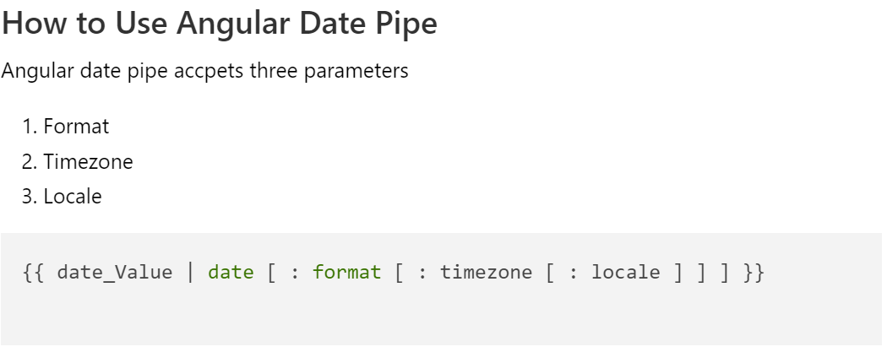
Built-in Pipe
1. DatePipe:

Slide 10
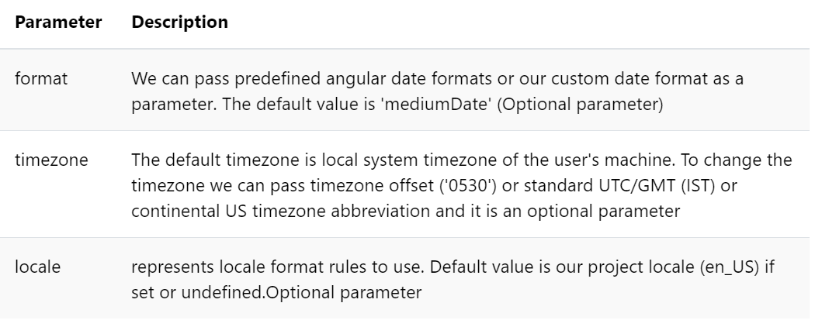
Built-in Pipe
1. DatePipe:

Slide 11
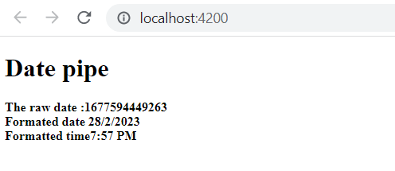
Built-in Pipe
1. DatePipe
app.component.html
<div>
<h1>Date pipe</h1>
<b>The raw date :{{todaydate}}</b><br/>
<b>Formated date {{todaydate | date:'d/M/y'}}</b><br/>
<b>Formatted time{{todaydate | date:'shortTime'}}</b>
</div>
app.component.ts
todaydate=Date.now()

Slide 12
Built-in Pipe
1. DatePipe
app.component.html
<p>DateTime as Milliseconds : {{todayNumber}}
datepipe:{{todayNumber | date}}</p>
<p>DateTime as object : {{todayDate}}
datepipe:{{todayDate | date}}</p>
<p>DateTime as string : {{todayString}}
datepipe:{{todayString | date}}</p>
<p>DateTime as iso string : {{todayISOString}}
datepipe:{{todayISOString | date}}</p>
todayNumber: number = Date.now();
todayDate : Date = new Date();
todayString : string = new Date().toDateString();
todayISOString : string = new Date().toISOString();
app.component.ts

Slide 13
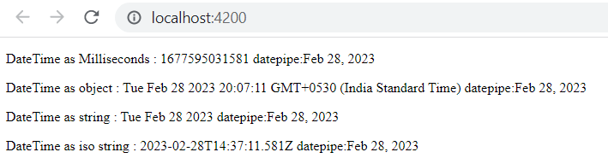
Built-in Pipe
1. DatePipe

Slide 14
Built-in Pipe
1. DatePipe: Predefined date formats
Date Format | Angular datepipe code | Result
M/d/yy, h:mm a | {{todayDate | date:'short'}} | 6/15/19, 10:54 PM
MMM d, y, h:mm:ss a | {{todayDate | date:'medium'}} | Jun 15, 2019, 10:54:25 PM
MMMM d, y, h:mm:ss a z | {{todayDate | date:'long'}} | June 15, 2019 at 10:54:25 PM GMT+5
EEEE, MMMM d, y, h:mm:ss a zzzz | {{todayDate | date:'full'}} | Saturday, June 15, 2019 at 10:54:25 PM GMT+05:30
M/d/yy | {{todayDate | date:'shortDate'}} | 6/15/19
MMM d, y | {{todayDate | date:'mediumDate'}} | Jun 15, 2019
MMMM d, y | {{todayDate | date:'longDate'}} | June 15, 2019
EEEE, MMMM d, y | {{todayDate | date:'fullDate'}} | Saturday, June 15, 2019
h:mm a | {{todayDate | date:'shortTime'}} | 10:54 PM
h:mm:ss a | {{todayDate | date:'mediumTime'}} | 10:54:25 PM
h:mm:ss a z | {{todayDate | date:'longTime'}} | 10:54:25 PM GMT+5
h:mm:ss a zzzz | {{todayDate | date:'fullTime'}} | 10:54:25 PM GMT+05:30

Slide 15
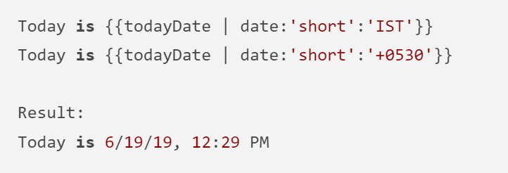
Built-in Pipe
1. DatePipe: Predefined date formats

Slide 16
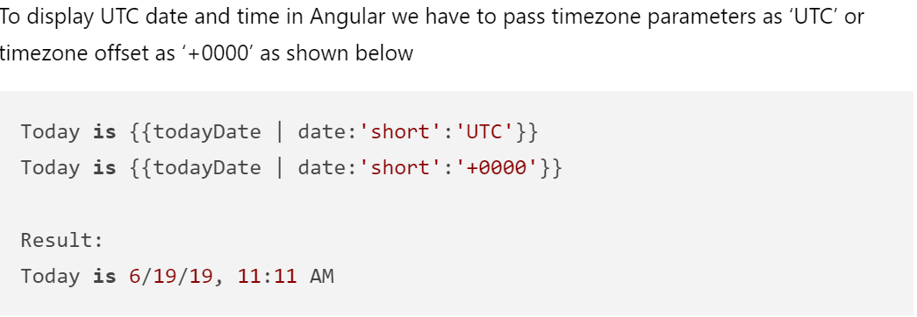
Built-in Pipe
1. DatePipe: Predefined date formats

Slide 17
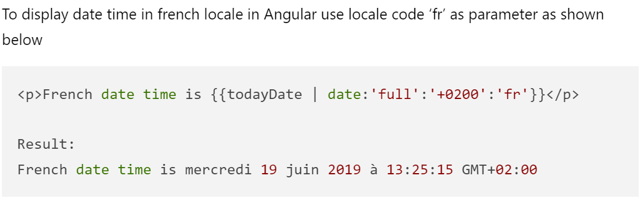
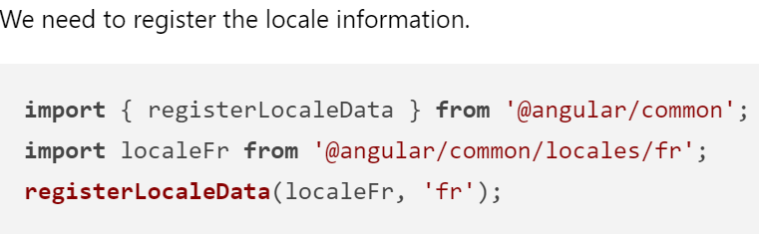
Built-in Pipe
1. DatePipe: Predefined date formats

Slide 18
Built-in Pipe
2. UpperCasePipe: Convert string/text to uppercase in Angular
UpperCasePipe Usage & Syntax
The syntax is very similar to other built in pipes, we need to pass input string to uppercase pipe without any parameters
{{ string | uppercase }}

Slide 19
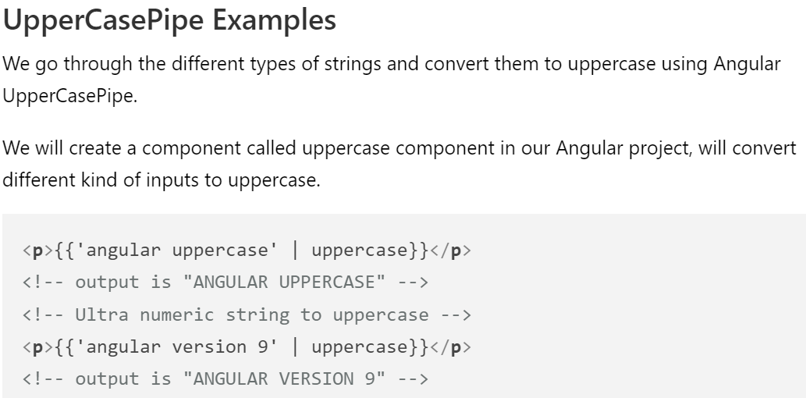
Built-in Pipe
1.UppercasePipe:

Slide 20
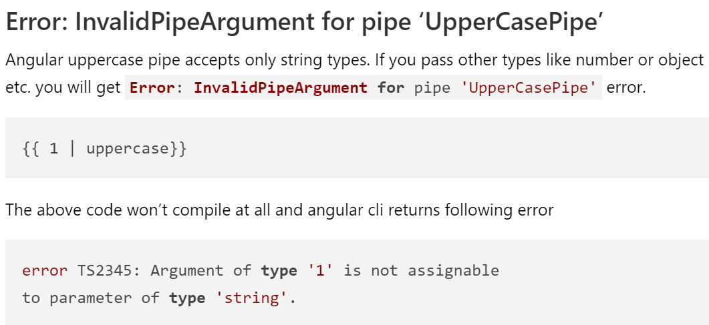
Built-in Pipe
2. UpperCasePipe

Slide 21
Built-in Pipe
3. LowerCasePipe:Convert string/text to lowercase in Angular
Lowercasepipe Usage & Syntax
The syntax is very similar to other built in pipes, we need to pass input text to the lowercase pipe without any parameters.
{{ text | lowercase }}

Slide 22
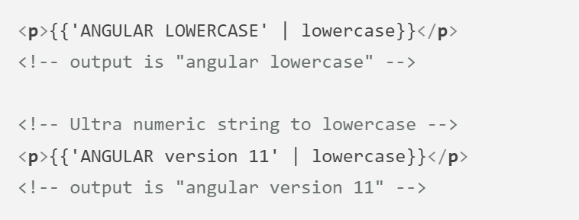
Built-in Pipe
3. LowerCasePipe:Convert string/text to lowercase in Angular

Slide 23
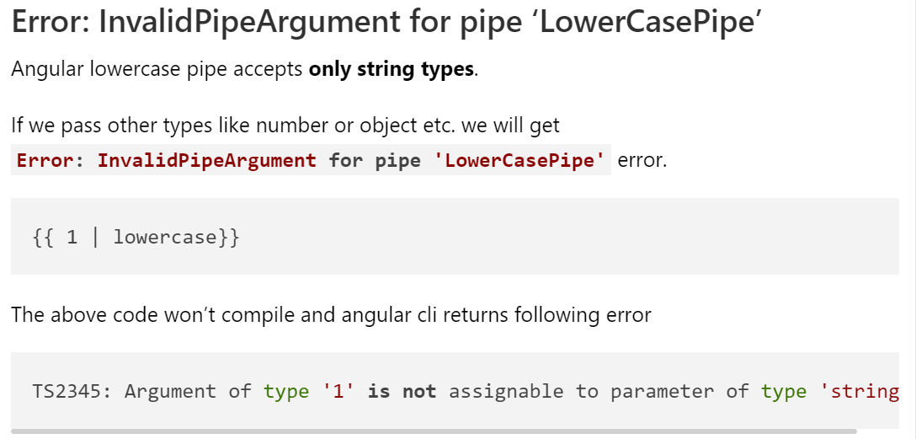
Built-in Pipe
3. LowerCasePipe:Convert string/text to lowercase in Angular

Slide 24
Built-in Pipe
4. Currency Pipe:
Angular Currency Pipe is one of the built-in pipe in Angular that can be used to format currency value according to given country code, currency, decimal, locale information.
Syntax:
{{ value_expression | currency [ : currencyCode [ : display [ : digitsInfo [ : locale ] ] ] ] }}

Slide 25
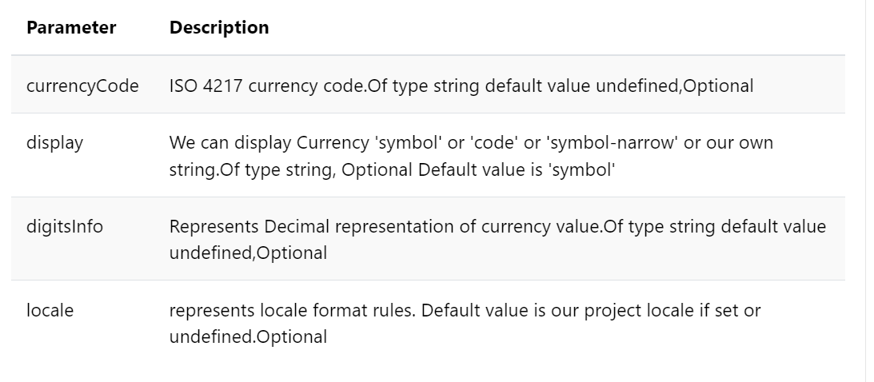
Built-in Pipe
4. Currency Pipe:

Slide 26
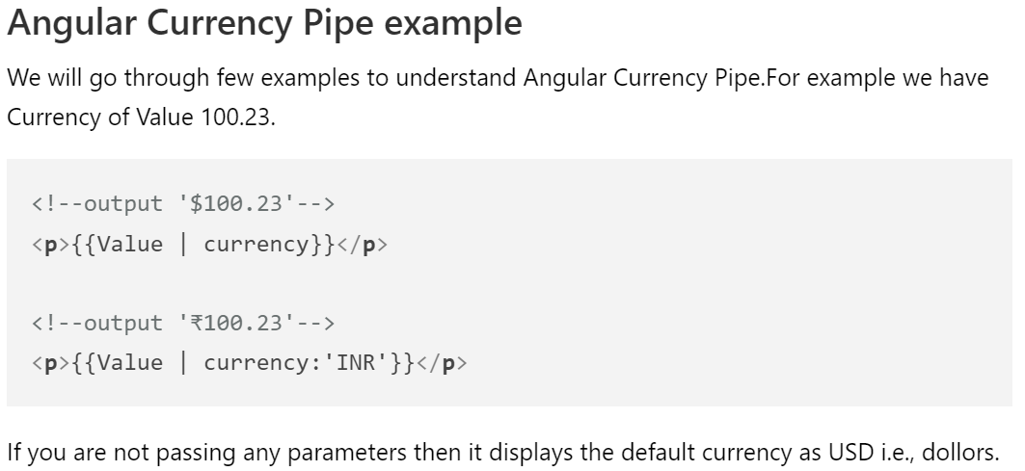
Built-in Pipe
4. Currency Pipe:

Slide 27
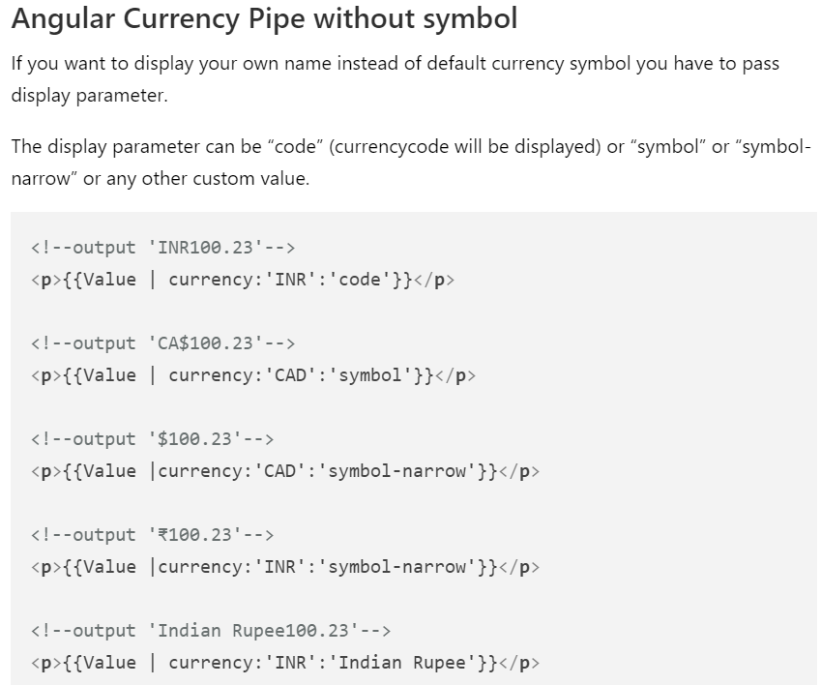
Built-in Pipe
4. Currency Pipe:

Slide 28
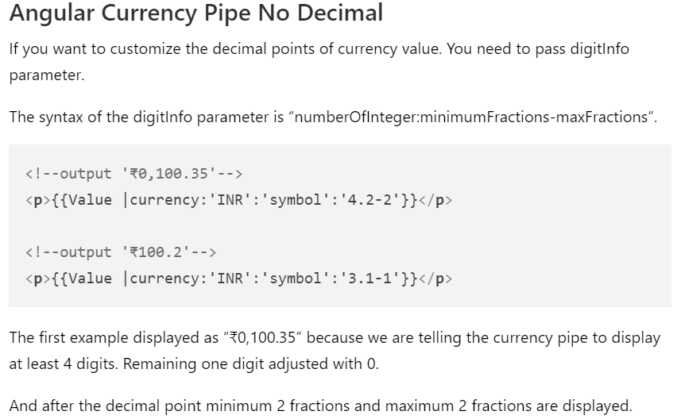
Built-in Pipe
4. Currency Pipe:

Slide 29
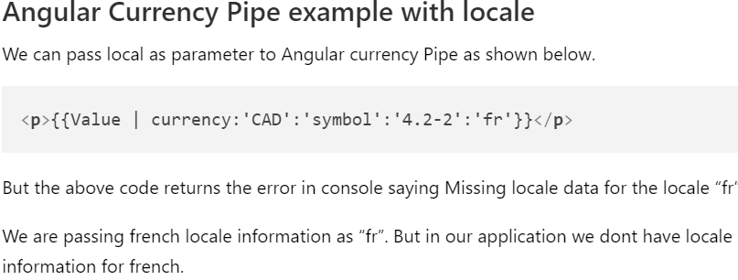
Built-in Pipe
4. Currency Pipe:

Slide 30
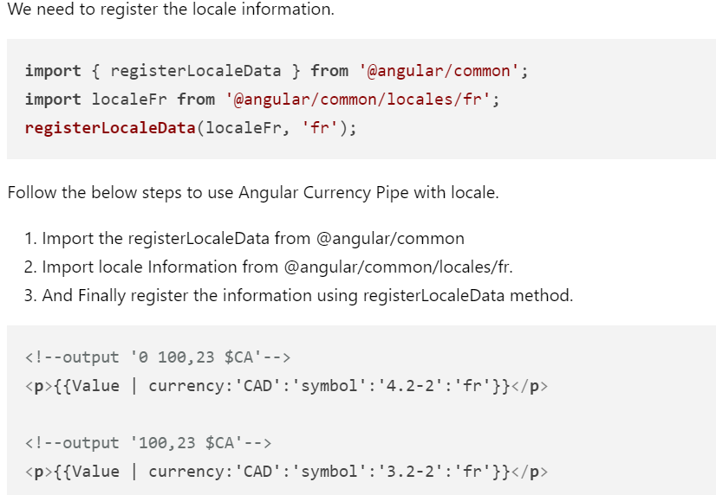
Built-in Pipe
4. Currency Pipe:

Slide 31
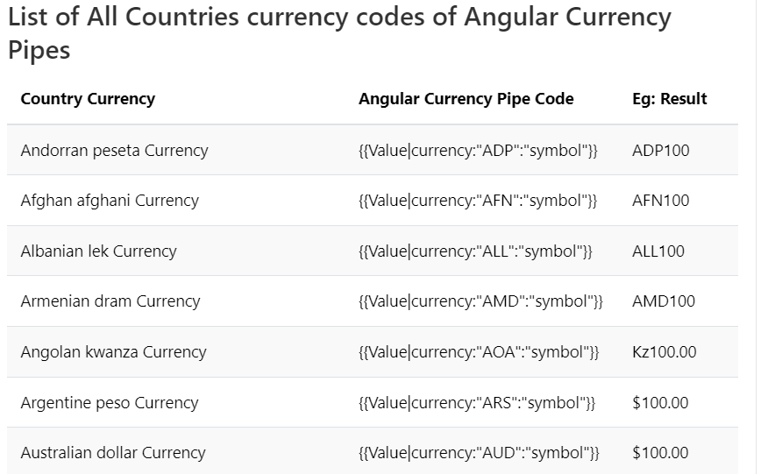
Built-in Pipe
4. Currency Pipe:

Slide 32
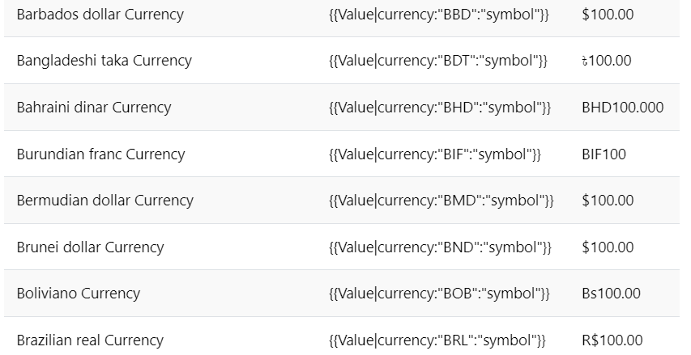
Built-in Pipe
4. Currency Pipe:

Slide 33
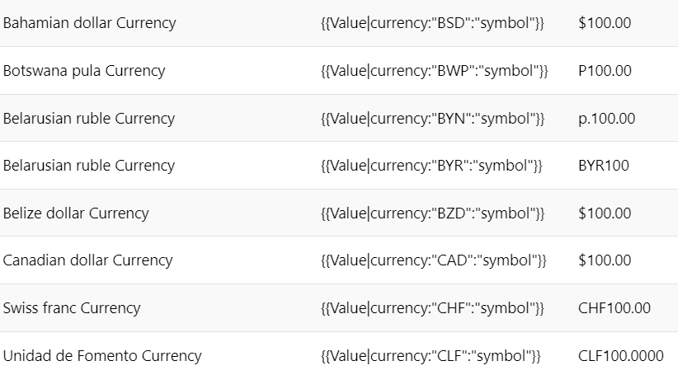
Built-in Pipe
4. Currency Pipe:

Slide 34
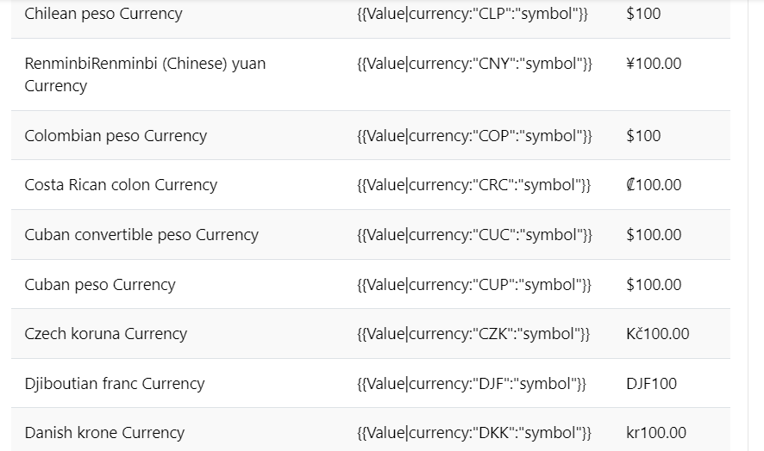
Built-in Pipe
4. Currency Pipe:

Slide 35
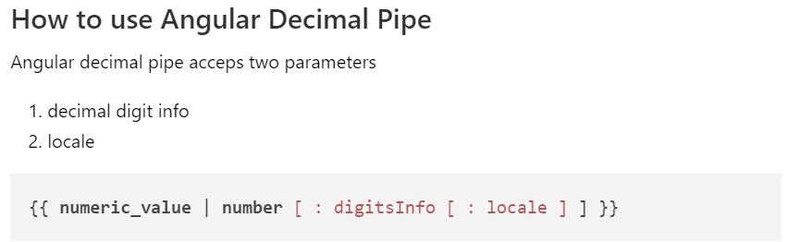
Built-in Pipe
5. Decimal Pipe:

Slide 36
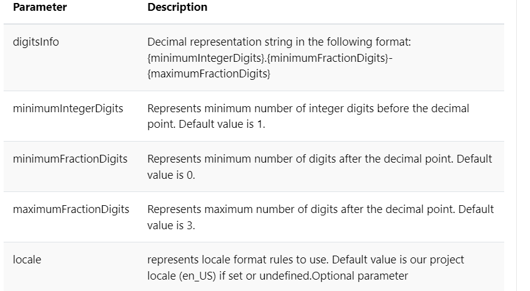
Built-in Pipe
5. DecimalPipe:

Slide 37
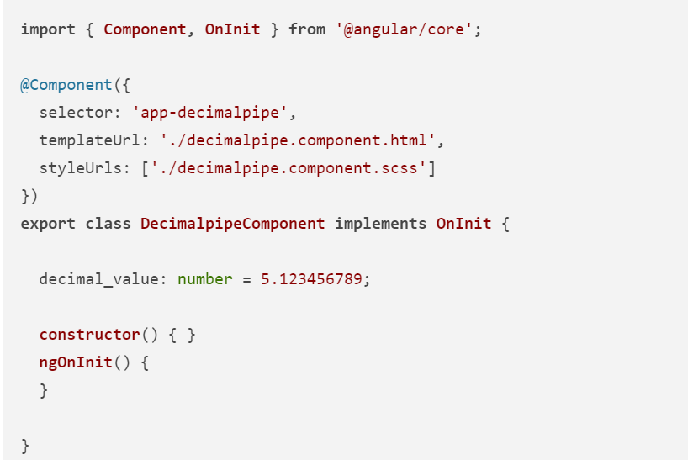
Built-in Pipe
5. DecimalPipe:

Slide 38
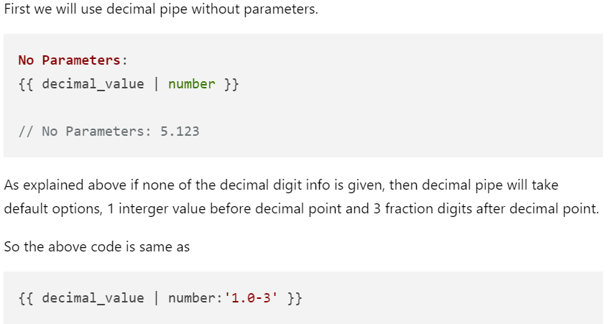
Built-in Pipe
5. DecimalPipe:

Slide 39
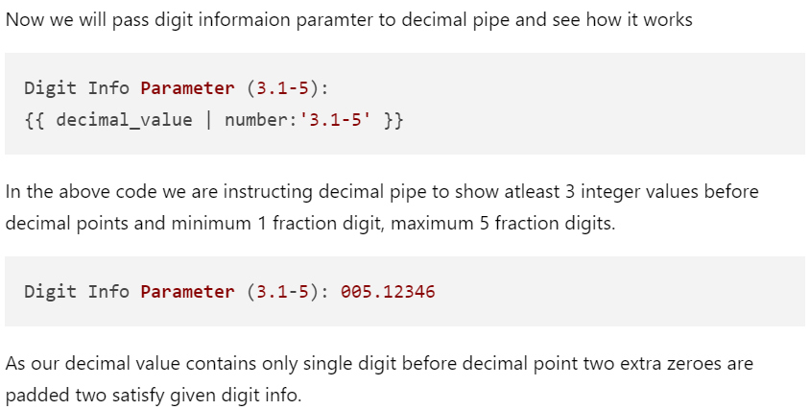
Built-in Pipe
5. DecimalPipe:

Slide 40
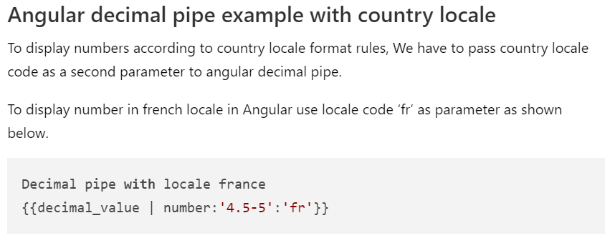
Built-in Pipe
5. DecimalPipe:

Slide 41
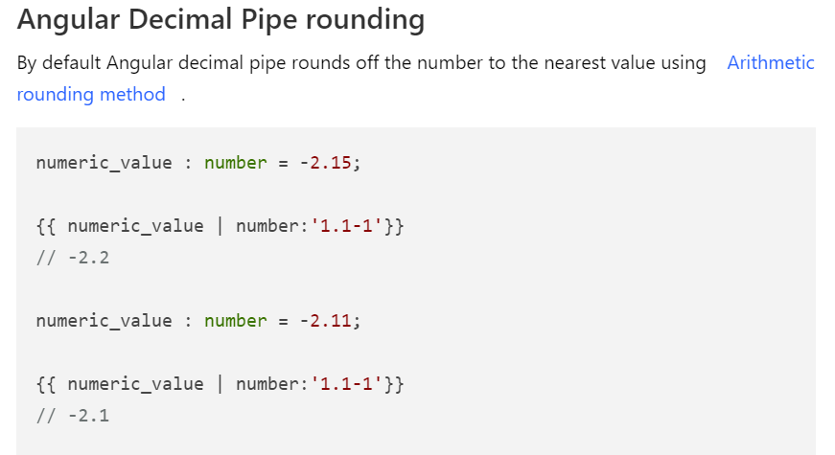
Built-in Pipe
5. DecimalPipe:

Slide 42
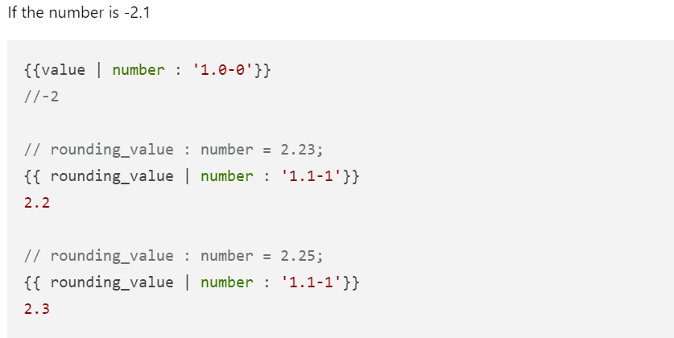
Built-in Pipe
5. DecimalPipe:

Slide 43
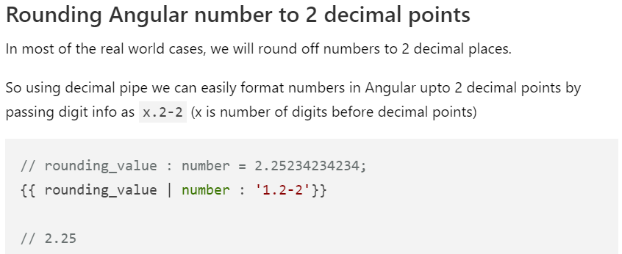
Built-in Pipe
5. DecimalPipe:

Slide 44
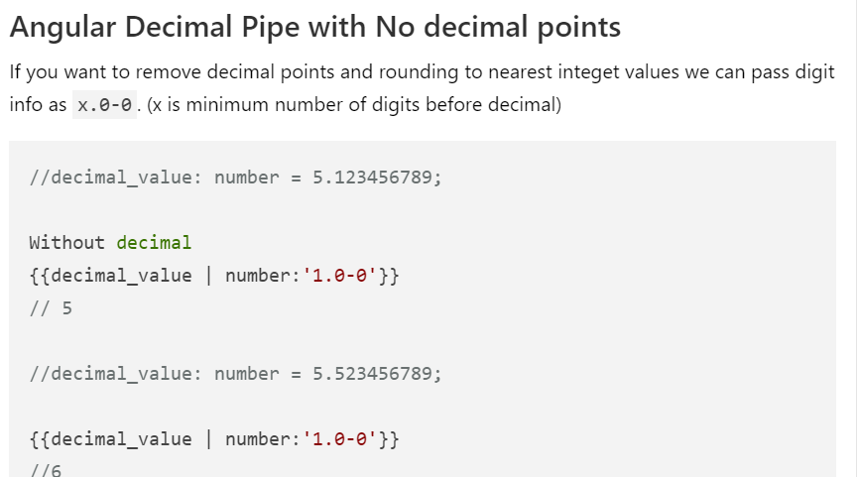
Built-in Pipe
5. DecimalPipe:

Slide 45
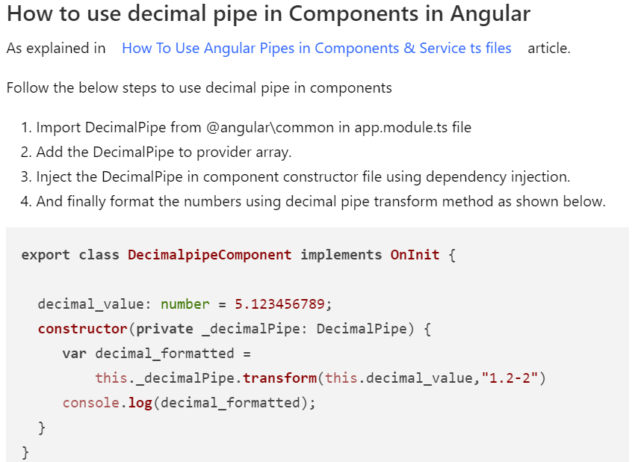
Built-in Pipe
5. DecimalPipe:

Slide 46
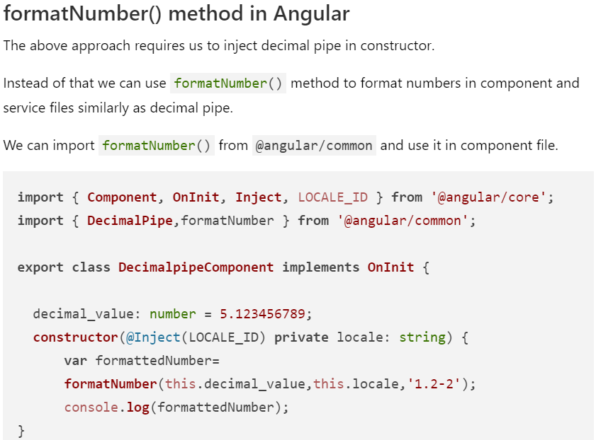
Built-in Pipe
5. DecimalPipe:

Slide 47
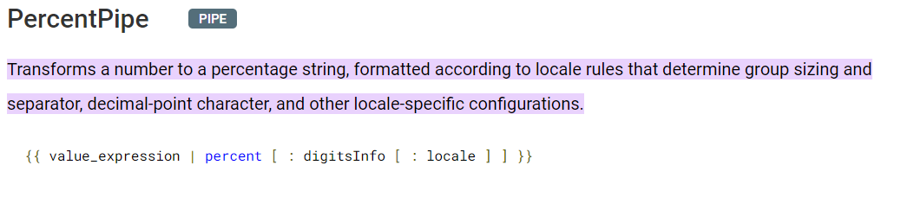
Built-in Pipe
6. PercentPipe:

Slide 48
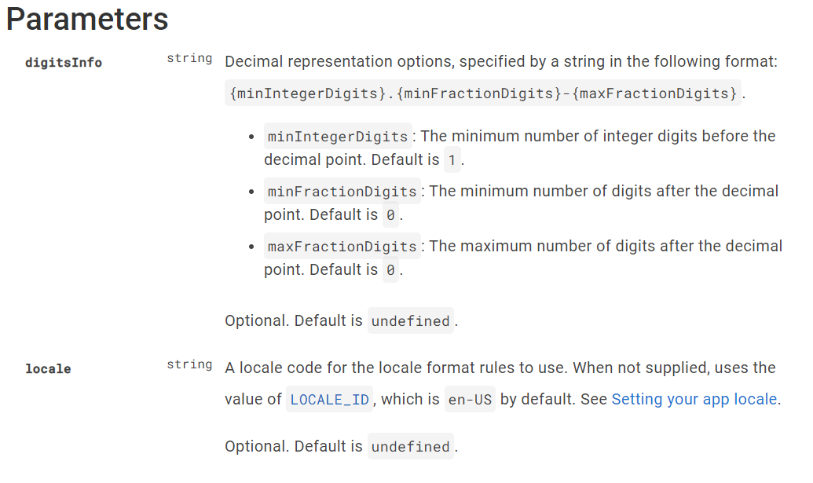
Built-in Pipe
6. PercentPipe:

Slide 49
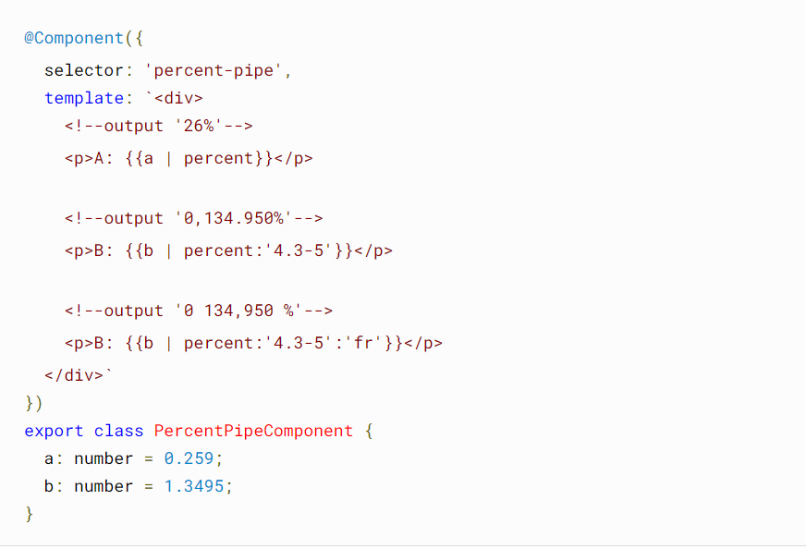
Built-in Pipe
6. PercentPipe:

Slide 50
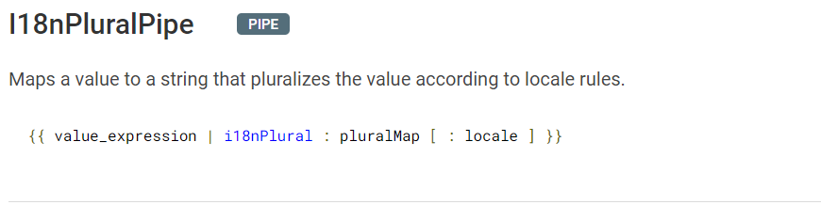
Built-in Pipe
7. l18nPluralPipe:

Slide 51
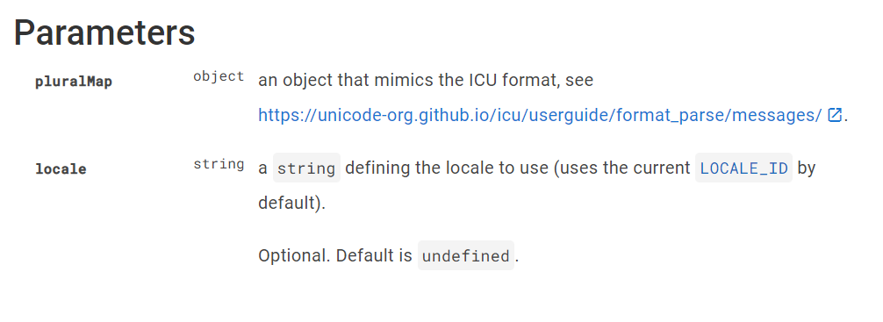
Built-in Pipe
7. l18nPluralPipe:

Slide 52
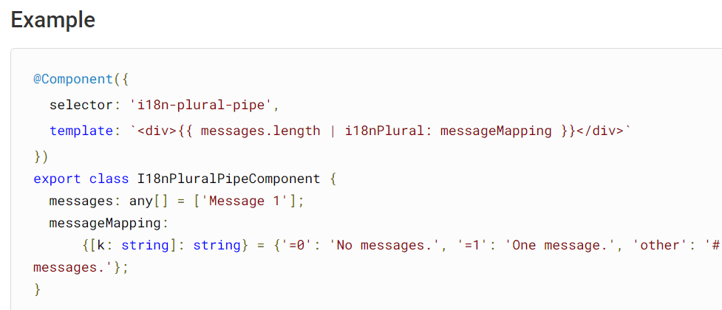
Built-in Pipe
7. l18nPluralPipe:

Slide 53

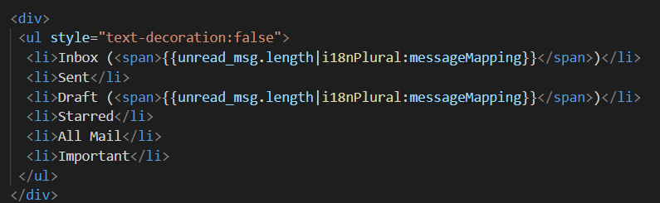
Built-in Pipe
7. l18nPluralPipe:
app.component.ts
app.component.html

Slide 54
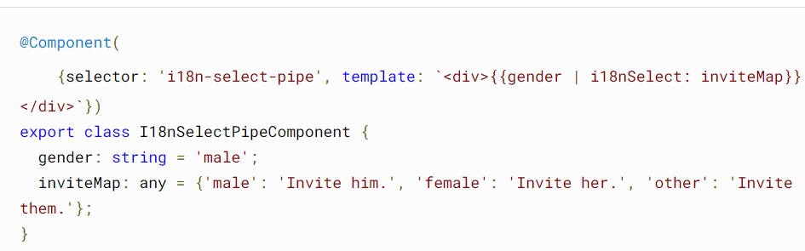
Built-in Pipe
8. l18nSelectPipe:
Generic selector that displays the string that matches the current value.
{{ value_expression | i18nSelect : mapping }}

Slide 55
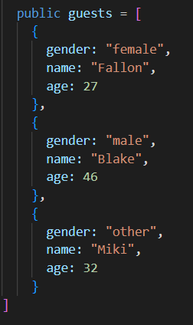
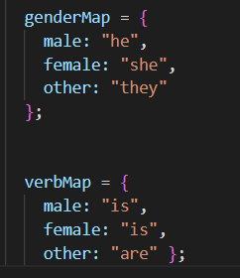
Built-in Pipe
8. l18nSelectPipe:
Declare the JSON object in app.component.ts

Slide 56
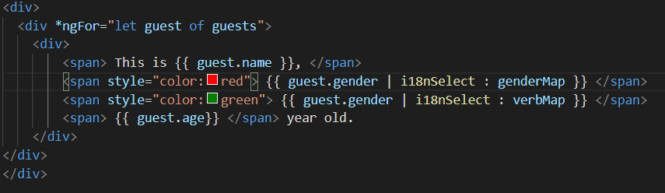

Built-in Pipe
8. l18nSelectPipe:

Slide 57
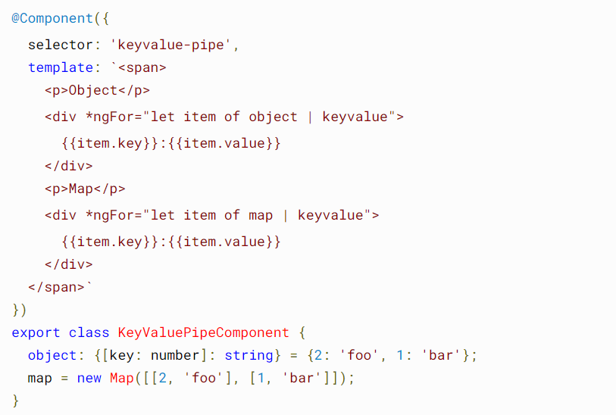
Built-in Pipe
8. KeyValuePipe:
Transforms Object or Map into an array of key value pairs.
{{ input_expression | keyvalue [ : compareFn ] }}

Slide 58
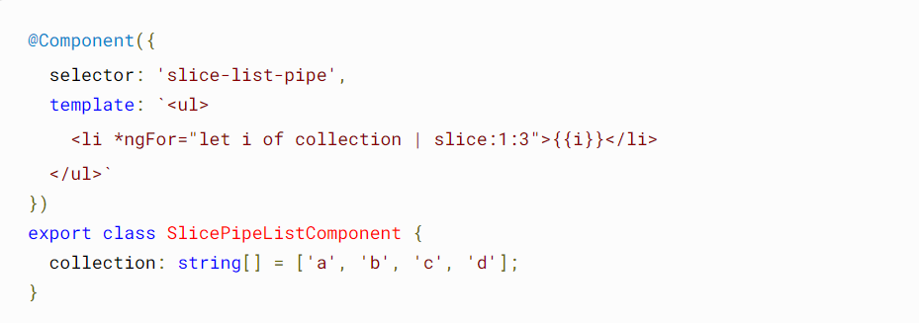
Built-in Pipe
9. SlicePipe:
Creates a new Array or String containing a subset (slice) of the elements.
{{ value_expression | slice : start [ : end ] }}

Slide 59
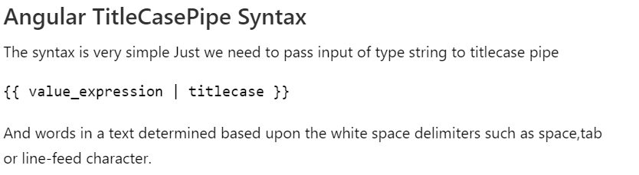
Built-in Pipe
10. TitleCasePipe:

Slide 60
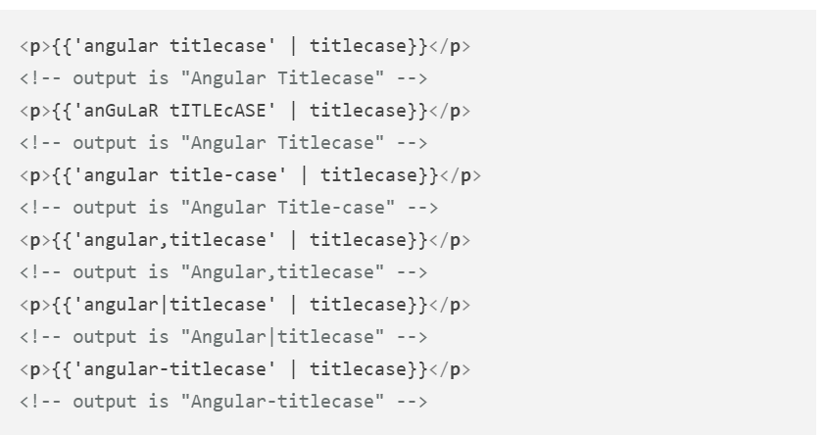
Built-in Pipe
10. TitleCasePipe:

Slide 61
Built-in Pipe
11. JSON Pipe:
JsonPipe
Converts a value into its JSON-format representation. Useful for debugging.
{{ value_expression | json }}

Slide 62

Built-in Pipe
11. JSON Pipe:

Slide 63

Custom Pipe
We can create a pipe which is not provided in angular.
We can use the pipe in template as we can do for built-in pipes
ng generate pipe add

Slide 64



Custom Pipe
3. Add in declaration of NgModule in app.mdoule.ts
2. Import in app.module.ts
4. Modify add.pipe.ts file

Slide 65


Custom Pipe
5. Use the add pipe in app.component.html

